Slide 1

Presentation By : Bhavya Batra
Committee Members : Dr. Susan Mengel (Chair)
Dr. Sepideh Ghanavati
Dr. Richard Watson
April 28th, 2017

Slide 2
The Blueprint
Introduction: SWE Origin
Introduction: SWE Operations
Introduction: SWE – OAWP
SWE-OAWP: Activity Diagram
SWE-OAWP: Design
SWE-OAWP: Architecture
SWE-OAWP: Class Diagram
SWE-OAWP: Use-Case Diagram
SWE-OAWP: Sequence Diagram
SWE-OAWP: Operation
SWE-OAWP: Testing
SWE-OAWP: What’s in the Future ?
SWE-OAWP: Related Works
SWE-OAWP: Now, Lets go Live !!

Slide 3
Introduction: The Beginning

Slide 4
Introduction: SWE-Operations

Slide 5
Introduction: SWE-OAWP

Slide 6
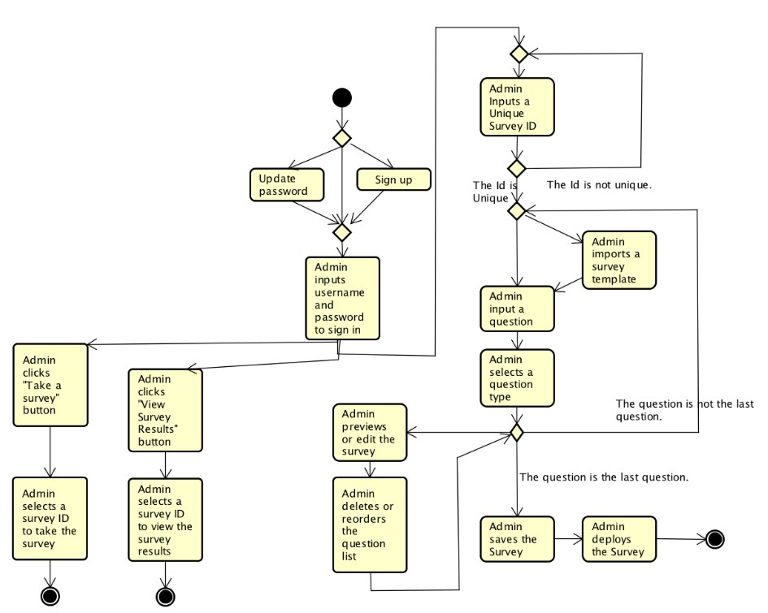
SWE-OAWP : Related Works
App Name : AutoSWE
Developed by YongJi Li
Under Dr. Susan Mengel,
May 2016

Slide 7
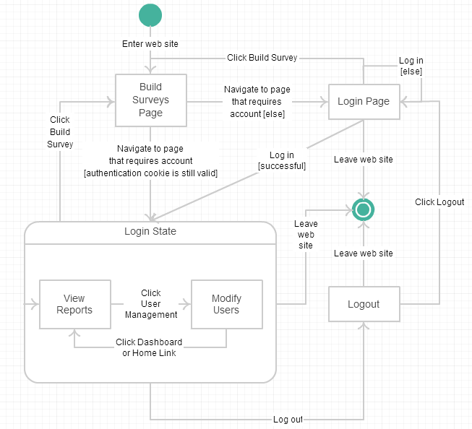
SWE-OAWP : Related Works
CS5364 project
Under Dr. Susan Mengel,
2014-2015

Slide 8



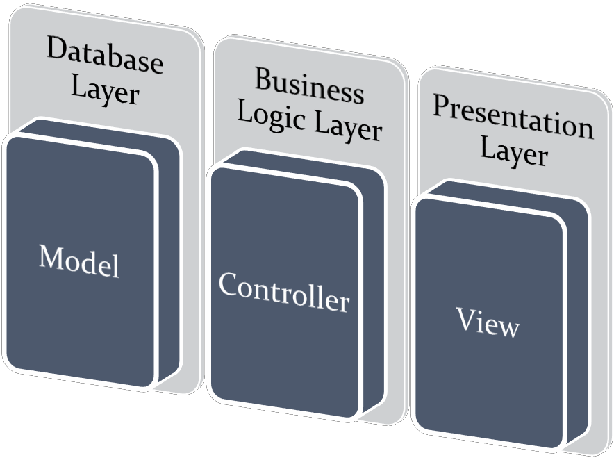
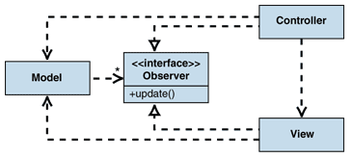
SWE-OAWP : The Design

Slide 9
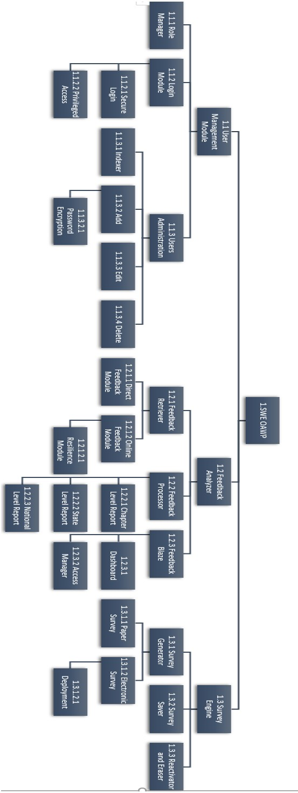
SWE-OAWP : Architecture

Slide 10
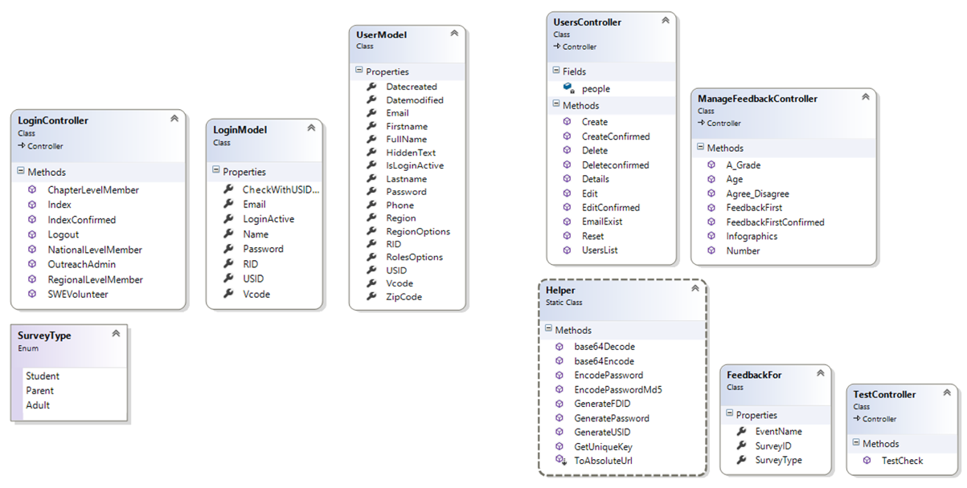
SWE-OAWP : Class-Diagram

Slide 11
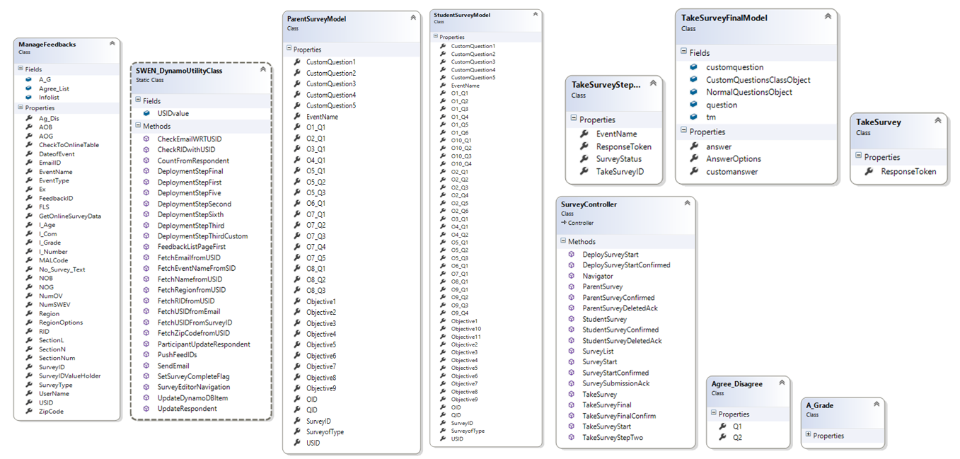
SWE-OAWP : Class-Diagram

Slide 12
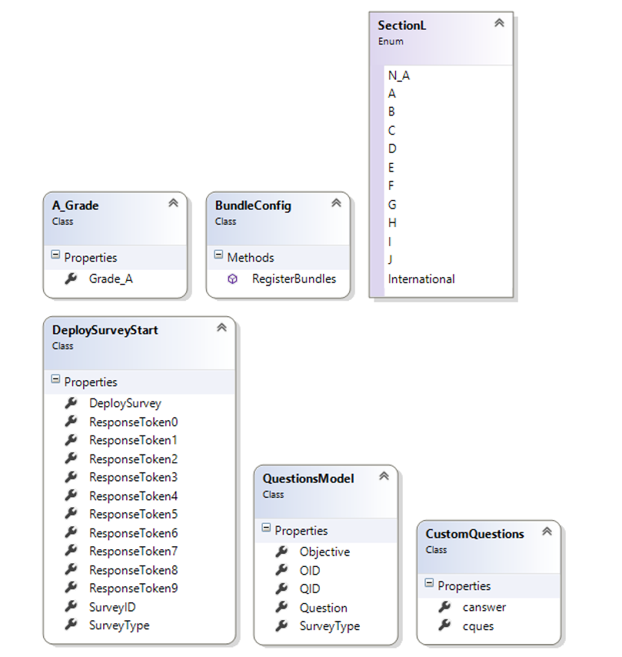
SWE-OAWP : Class-Diagram

Slide 13
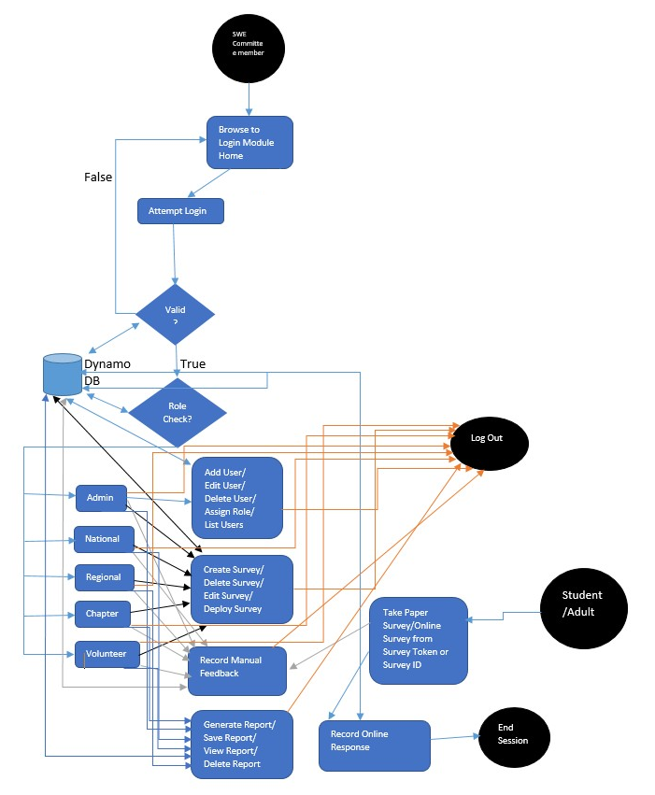
SWE-OAWP : Activity Diagram

Slide 14
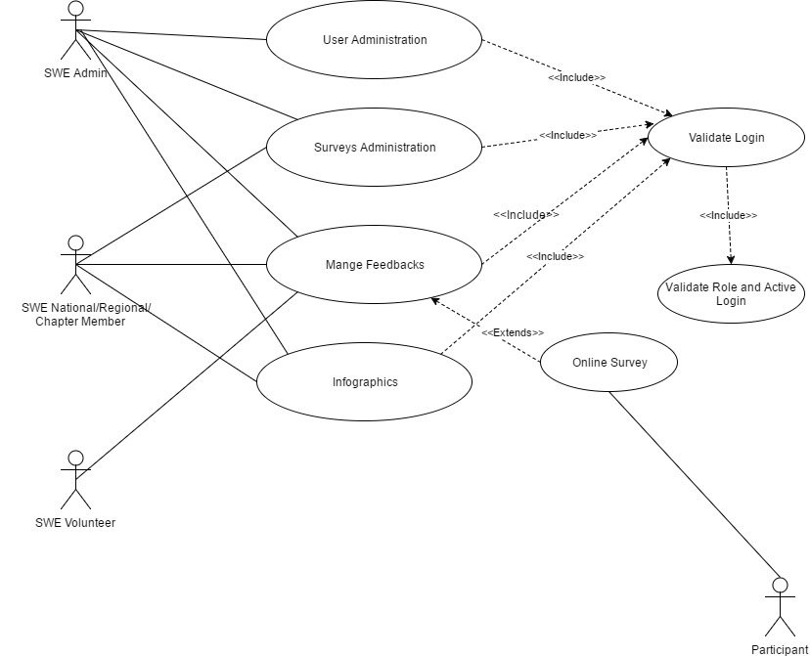
SWE-OAWP : Use-Case Diagram

Slide 15
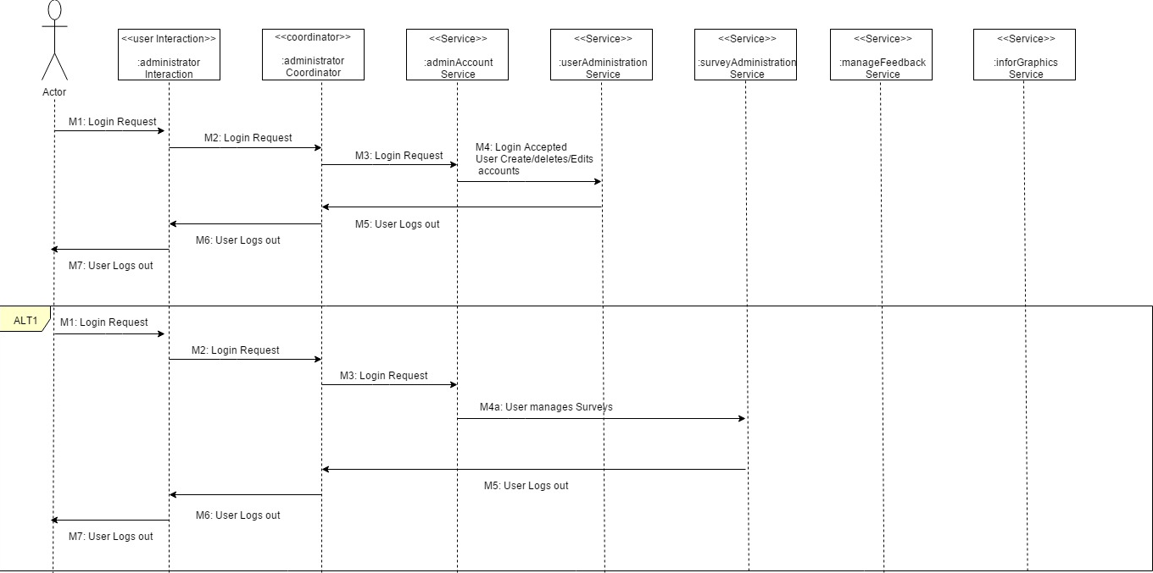
SWE-OAWP : Sequence Diagram

Slide 16
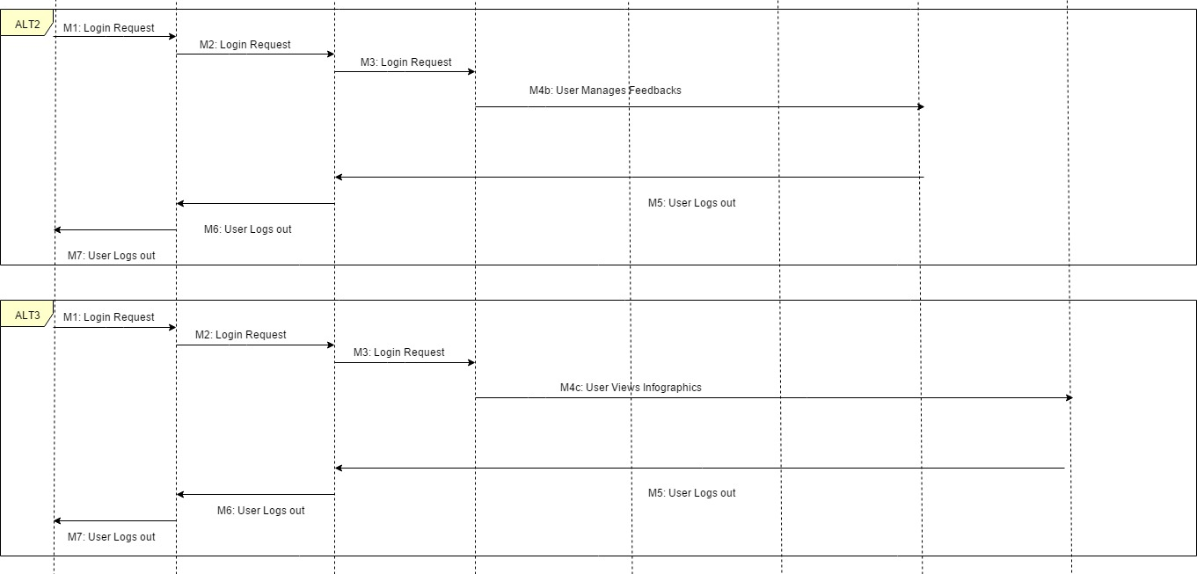
SWE-OAWP : Sequence Diagram

Slide 17
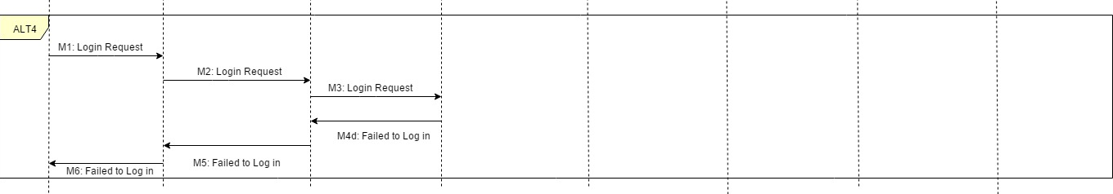
SWE-OAWP : Sequence Diagram

Slide 18
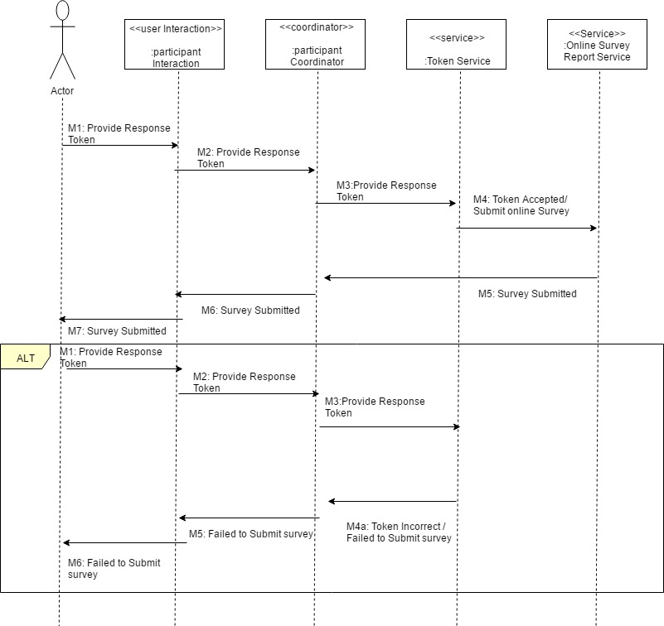
SWE-OAWP : Sequence Diagram

Slide 19
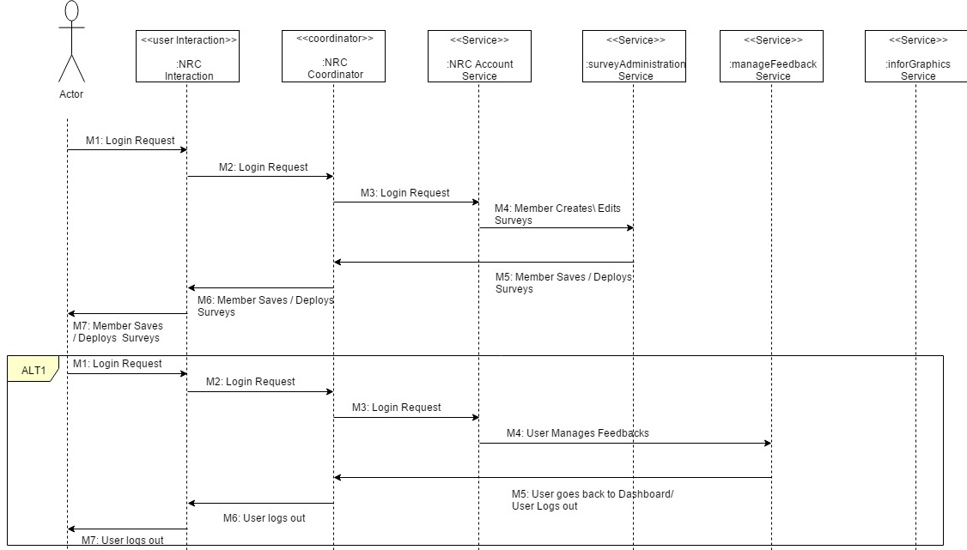
SWE-OAWP : Sequence Diagram

Slide 20
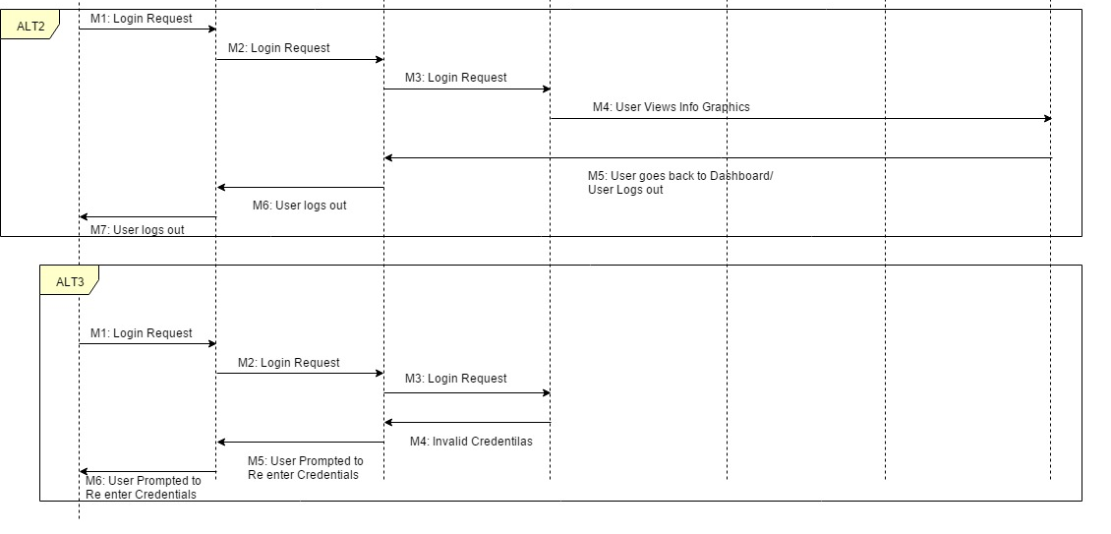
SWE-OAWP : Sequence Diagram

Slide 21
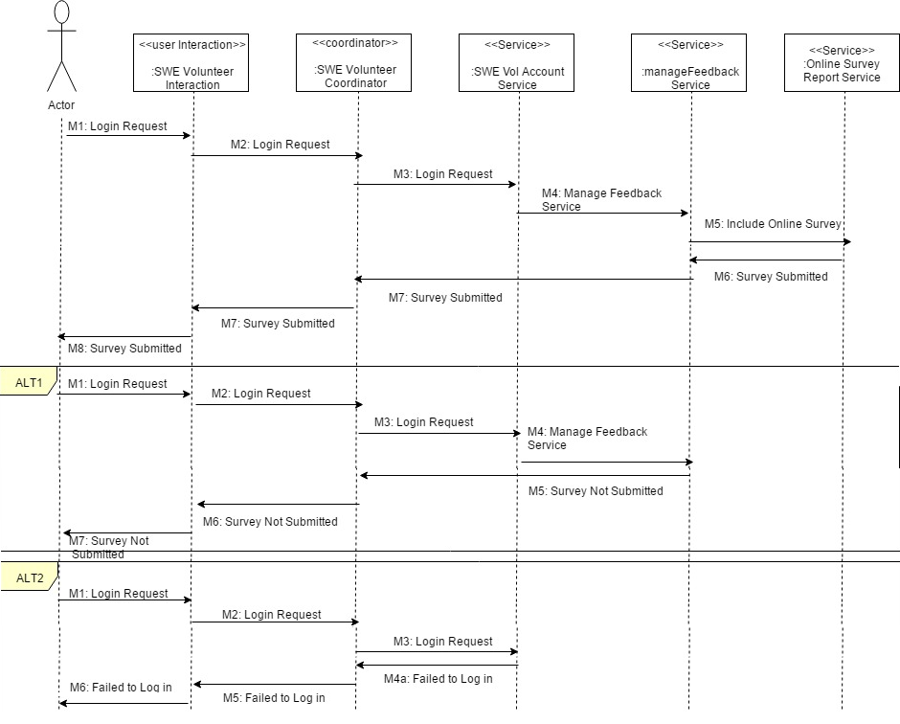
SWE-OAWP : Sequence Diagram

Slide 22
SWE-OAWP : In-Operation

Slide 23
SWE-OAWP : Testing
#Number | Tester Name | Assigned Role | Department
1 | Vinay Deshpande | Outreach Admin | Computer Science
2 | Manohar Kotapati | National Level Admin | Computer Science
3 | Vibhuti Gupta | National Level Admin | Computer Science
4 | Abdullah Ejaz | Regional Level Admin | Computer Science
5 | Phani Cherukuri | Regional Level Admin | Computer Science
6 | Vidya Eswarappa | Chapter Level Admin | Computer Science
7 | Anjikya Tiwari | Chapter Level Admin | Computer Science
8 | Jose Salazar | SWE Volunteer | Law
9 | Gaurav Vinayaka | SWE Volunteer | Computer Science
10 | Mayuresh Indapurkar | SWE Volunteer | Data Science
11 | Tania Singh | Participant | Law
12 | Sara Khan | Participant | Law
13 | Arun Jegarkal | Participant | Computer Science
14 | Vinay Deshpande | Participant | Computer Science
15 | Bhavya Batra | Participant | Computer Science-SE

Slide 24
The Blueprint

Slide 25
The Blueprint

